Slide 1

The European Baccalaureate • S7
Informations from :
https://www.eursc.eu/en/European-Schools/European-Baccalaureate
S7- Session #1 – 23 September 2022
Orientation Team

Slide 2
Links for the European Baccalaureate + HANBOOK Edition 2024
https://www.eeb1.com/en/pedagogical-information/european-baccalaureate/
https://www.eursc.eu/Documents/BAC_Handbook-en.pdf
https://www.eursc.eu/Documents/BAC_Handbook-fr.pdf
https://www.eursc.eu/Documents/BAC_Handbook-de.pdf
S7- Session #1 – 23 September 2022

Slide 3
European Baccalaureate (E B) Guide
On the website eursc.eu
https://www.eursc.eu/Documents/BAC_Handbook-en.pdf
Forms
Marks C , W, O : scenarios?
C Mark?
Examinations: E, O
S7- Session #1 – 23 September 2022
Orientation Team

Slide 4
Arrangements for Implementing E B
v

Slide 5
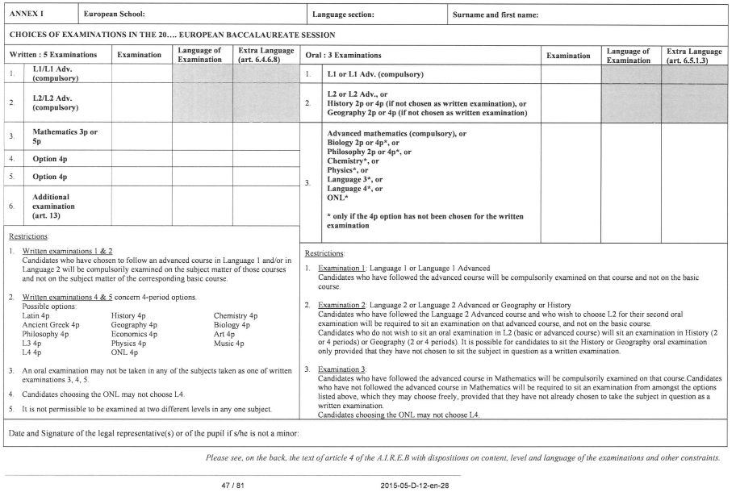
FORMS : DEADLINE OCTOBER 6 ^{th}

Slide 6
Additional examination
In particular cases, European School pupils in the final school year may register for the European Baccalaureate in an additional option subject, whether or not they have attended lessons in the subject in question at the School.
EXCEPT ARTS & MUSIC : specific syllabus requirements
(Article 13 page 41 ofde 2015-05-D-12-en-32)
Additional examination= WRITTEN Exam
REQUEST to for an additional written exam : October 6 th
S7- Session #1 – 23 September 2022
Orientation Team

Slide 7
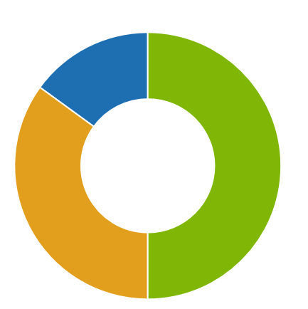
European Baccalaureate Guide
O
C : preliminary mark
W : Written exam
O : Oral exam
C
W
S7- Session #1 – 23 September 2022
Orientation Team

Slide 8
Proportion of the different components
Preliminary average C Mark: 50% of the final score
W mark, average of written tests: 35% of final score
O Mark, average of the oral tests : 15% of the final result
S7- Session #1 – 23 September 2022
Orientation Team

Slide 9
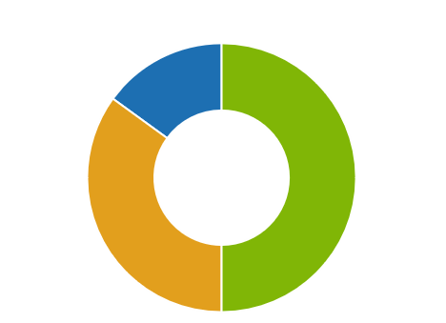
Proportion of the different components
FINAL RESULT= 0.50* C + 0.35 W + 0.15 O
Possible Scenarios :
Final grade of a subject :
(C x 0.5 + W x 0.35 + O x 0.15)
O 15 %
Example :
L I or L I Appro
L II or L II Appro
W 35 %
C 50 %
S7- Session #1 – 23 September 2022
Orientation Team

Slide 10
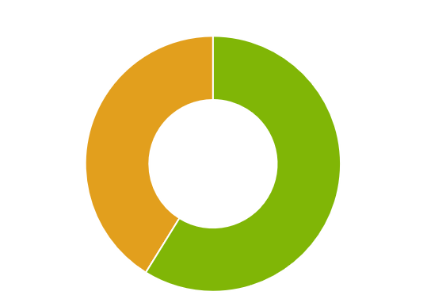
Proportion of the different components
Possible Scenarios :
Final grade of a subject :
(C x 0,5 + E x 0.35) / 0,85
W 41 %
C 59 %
Example :
Option 4 P
S7- Session #1 – 23 September 2022
Orientation Team

Slide 11
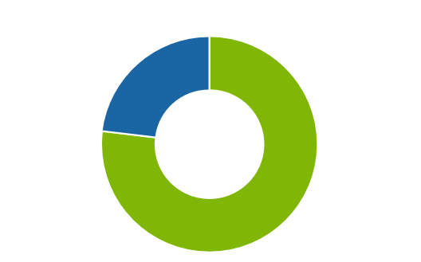
Proportion of the different components
Possible Scenarios :
Final grade of a subject :
(C x 0,5 + O x 0,15) / 0,65
O 23 %
C 77 %
Example :
Option 4 P ou Subject 2 P or advanced Math
S7- Session #1 – 23 September 2022
Orientation Team

Slide 12
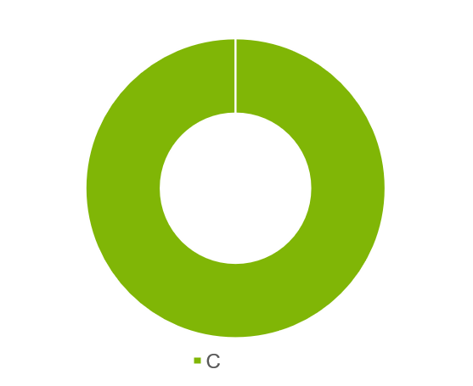
Proportion of the different components
Possible Scenarios :
Final grade of a subject :
C
No Oral / no Written
C 100 %
S7- Session #1 – 23 September 2022
Orientation Team

Slide 13
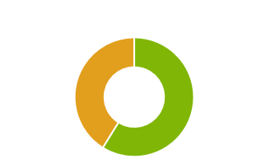
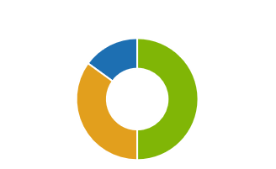
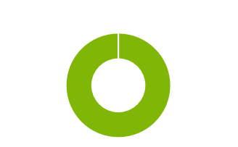
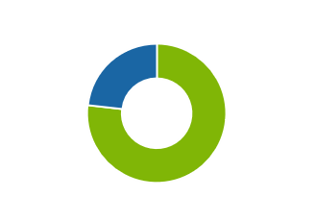
Proportion of the different components
FOUR Possible Scenarios :
Final grade of a subject :
(C x 0,5 + E x 0,35 + O x 0,15)
(C x 0,5 + E x 0,35) / 0,85
(C x 0,5 + O x 0,15) / 0,65
C

Slide 14
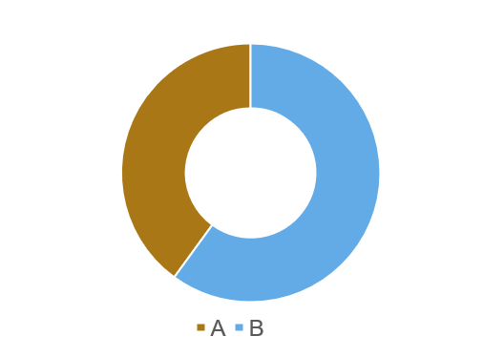
Preliminary Mark (C, 50%)
Resulting from two elements:
Class grades (A grades): 20 points out of 50 in the calculation of the preliminary grade
Partial test grades (B grades): 30 points out of 50 in the calculation of the preliminary grade.
A 20 %
B 30 %
C
S7- Session #1 – 23 September 2022
Orientation Team

Slide 15
A Mark (A, 20%)
Shall reflect the candidates' performance in their class work.
The class grade will be the average of the 2 A grades from each semester (except moral/religion).
S7- Session #1 – 23 September 2022
Orientation Team

Slide 16
B mark, 30%
Partial test scores (short and long): Harmonized within the school
**Short**Exams of 2 Periods
December 2022 and April/May 2023
One exam per semester for Philo2,Advanced maths and complementary courses
2 exams (1 period) per semester during the courses for bio2, geo2, his2
A HARMONIZED TEST (Duration: 2 periods)
Tests organized at the end of the sequences for physical education
S7- Session #1 – 23 September 2022
Orientation Team

Slide 17
Partial exam grades (B, 30%): Harmonized within the school
PREBAC –Written long exams (JANUARY)
Language I,
Language II,
Maths (3 & 5 periods),
All 4 periods options
Advanced L I,
Advanced L II.
S7- Session #1 – 23 September 2022
Orientation Team

Slide 18
Final written exams (W, 35%) Harmonized in ALL European schools
5 Written exams:
Language I / advanced Language I
2. Language II / advanced Language II
Attention : Advanced LI and Advanced L II take precedence over LI and LII
→ Written : Advanced language
S7- Session #1 – 23 September 2022
Orientation Team

Slide 19
Final written exams (W, 35%) Harmonized in ALL European schools
5 written exams :
3. Maths 5 periods or 3 periods
4. Option 4 periods
5. Option 4 periods
Duration of exams (see Annex)
4h for LI, LII, maths 5p, 5h for arts,
3h others except Philo 4 (3 h au Prebac & 4 h au bac)
Double examination (Teacher + External)
S7- Session #1 – 23 September 2022
Orientation Team

Slide 20
3 Oral exams (O, 15%)
two reviewers (teacher+ external)
20 min preparation / 20 min oral examination
O1 | O2 | O3
Langue I ou Langue I Appro | Langue II Langue II Appro HIST (2P ou 4P) Géo (2P ou 4P) | Maths Appro Philo (2P ou 4P) Langue III Langue IV ONL Bio (2 ou 4) Chimie Physique
S7- Session #1 – 23 September 2022
Orientation Team

Slide 21
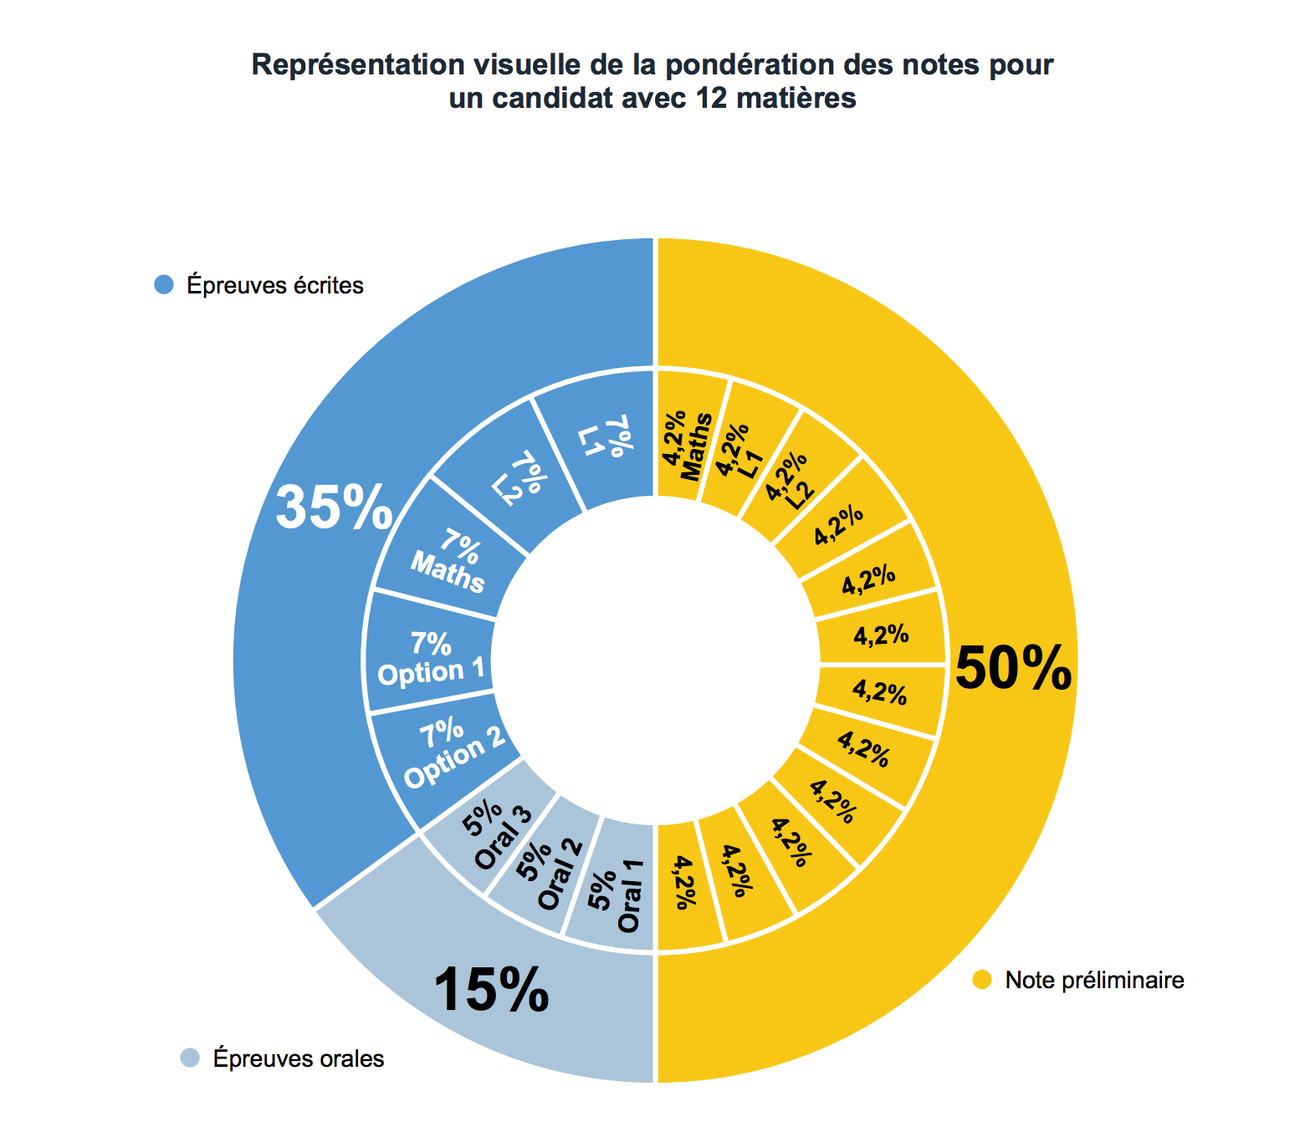
Weighting of the exams
Visual representation of the grade weighting of a candidate with 12 subjects
S7- Session #1 – 23 September 2022
Orientation Team

Slide 22

Weighting of the exams
Visual representation of the grade weighting of a candidate with 12 subjects
11 subjects
10 Subjects
11 Matières
4,5 %
5 %
50 %
50 %
S7- Session #1 – 23 September 2022
Orientation Team

Slide 23
PRELIMINARY mark CALCULATION (before the Bac tests - May 2023)
Preliminary grade for a subject chosen for a written or oral examination (Bio or Chemistry):
20% A (1st S) + 20% A (2nde S) + 60 % B (1st S)
= 0,2 * A (1st)+ 0,2 * A (2nde) +0,6 * B (1st)
Preliminary grade for a subject not chosen for a written nor oral examination(PE)
20% A (1st S) + 20% A (2nde S) + 30 % B (1st S)+ + 30 % B (2nde S)
= 0,2 * A (1er)+ 0,2 * A (2nde) +0,3 * B (1er) + 0,3 * B (2nde)
S7- Session #1 – 23 September 2022
Orientation Team

Slide 24
En Bref :
C
A
A test and class work
20 %
B
Short exams (December – May)
June
5 written exams (LI / Appro, LII / advanced, Maths, two subjects Option 4 p)
W
Long exams – Prebac (Jan)
30 %
7 % per exam = TOTAL 35 %
O
  3oral exams (LI / Appro, ….
  5 % per examen = TOTAL 15 %
Deadline
  7 OCTOBRE 2022
S7- Session #1 – 23 September 2022
Orientation Team
NOTE A | NOTE B | NOTE
Test A Et Travail en classe…. | 2 EPREUVES COURTES (Décembre et Mai) EPREUVES LONGUES (Prebac) JANVIER | Maths Appro Philo (2 ou 4) Langue III Langue IV ONL Bio (2 ou 4) Chimie Physique

Slide 25
Annexe
Subject (# periods) | Exam duration
LI (4 P) | 4 H
LII (3 P) | 3H
Math (5 P) | 4 H (1 h with technological support)
Math (3 P) | 3 H (without technological support)
Math Appro (3 P) | 1st exam : 2 P ( at least 1 p with technological support) 2nde exam : 2 P (at least 1 p with technological support)
Histoire L II (2 P) | 1 exam 2 P / 2 exams 1 P
Géographie L II (2 P) | 1 exam 2 P / 2 exams 1 P
Biologie L I (2 P) | 1 exam 2 P / 2 exams 1 P
Philosophie (2 P) | 2 P (90 min)
Appro L I (3 P) | 4 H
Appro L II (3 P) | 4 H
L III (4 P) | 3 H
L IV ou ONL (4 P) | 3 H
Latin (4 P) | 3 H
Grec Ancien | 3 H
Histoire L II (4 P) | 3 H
Géographie L II (4 P) | 3 H
Biologie L I (4 P) | 3 H
Philosophie (4 P) | 4 H (3 H - prébac)
Physique (4 P) | 3 H
Chimie (4 P) | 3 H
Economie L II (4 P) | 3 H
ART (4 P) | 5 H
Musique (4 P) | 3 H
Autre Matière | 3 H
S7- Session #1 – 23 September 2022

Slide 26
Formulaire à remplir : Date LIMITE 6 OCTOBRE
v
v
Mail from Ms Lovens :
08/09-23

Slide 27
Registration for payment
DOSSIERS UNIVERSITAIRES
UCAS
PARCOURSUP
NL applications
https://forms.office.com/Pages/ResponsePage.aspx?id=aeA505McU0OzBwsicDW6Qtr5dB9aK0tIp7HHlEGcxchURE82UVlYNFlXTDhQNUJIVjE4U1U2Q0hFUi4u
S7- Session #1 – 23 September 2022

Slide 28
Thank you for your attention
Questions?
Orientation team
S7- Session #1 – 23 September 2022

