Slide 1
Geography
"Geography is a subject which holds the key to the future" Michael Palin

Slide 2
Year 6: 2 period Course
(Detailed syllabus –refer to The European School website-Syllabus- Secondary-Other Subjects. http://www.eursc.org)
4 main themes to be studied this year
Development
Globalisation
Managing the Earth’s Resources
Environment in Danger: managing the threats
Project- choice at the discretion of the teacher-usually linked to one of the themes.
Tests and assessment
A mark : an effort mark, based on attitude, quality of homework and class work.
B mark- A total of 4 B tests in year 6 based on the four themes.
Tests are 45 minutes and take place during class.

Slide 3
Year 7: 2 period Course
Focus on Europe
(Detailed syllabus –refer to The European School website-Syllabus- Secondary-Other Subjects. http://www.eursc.org)
4 main themes to be studied this year
Europe and the European Union
The Economic Sector in Change
Europeans
A Natural Environment increasingly modified by man
Tests and assessment
A mark : an effort mark, based on attitude, quality of homework and class work.
B mark- A total of 4 B tests in year 7 based on the four themes.
Possibility of taking an oral Exam in June

Slide 4
Year 6: 4 period Course
Global Geography
The four compulsory subjects are:
Physical geography and human activity through the study of landscapes and natural hazards
The study of natural resources
The complexity of a global world through the study of uneven development and globalisation
The last topic is a field study (currently in the Alps) during which students will be involved in their learning (setting objectives, data collection, data processing, analysis of results and conclusions )
Examinations and assessment
A mark: semester consists of written tests and homework assignments ( individual or group ) . It will take account of the investment of the student in the classroom and at home.
B mark: Two exams of 2 hours 15 minutes, one in December and one in June.

Slide 5
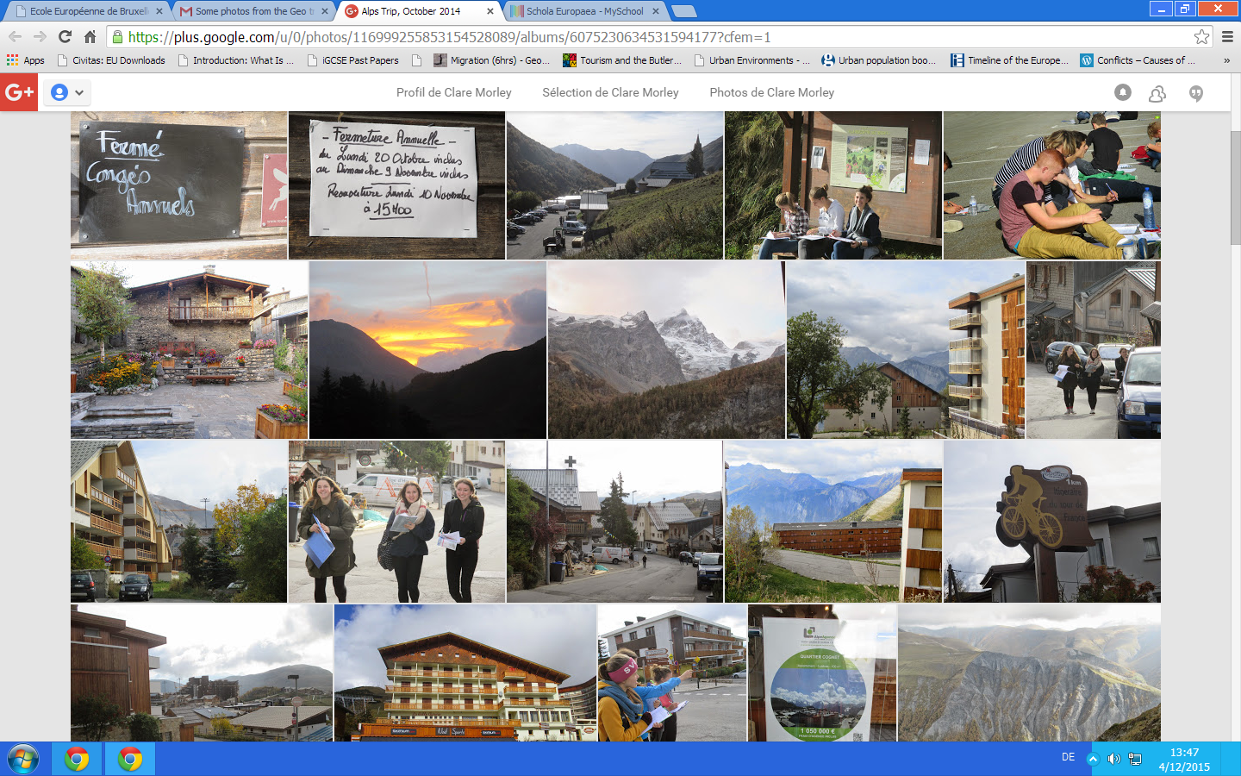
Geography Fieldwork : Every year a dedicated team of Geography teachers take our S6 4 period Geography students into the field to study the Alpine environment. The skills they learn and the landscapes they have discovered, remain with them past the BAC.

Slide 6
Skills
Skills form an essential element of the 6.4 geography syllabus
Topographical maps
Weather maps
Photographs
Satellite images
Sketches
System diagrams
Graphs
Statistics
Images
Texts
Data gathering

Slide 7
Year 7: 4 period Course The European Union
The four compulsory subjects are:
The European natural environment ( terrain and climate )
The European population (distribution, demography, migration )
The European economy (agriculture, industry and services)
Challenges and issues in the European Union ( EU operation , sustainable development, energy policy and CAP, enlargement, deepening.
Examinations and assessment
A mark: semester consists of written tests and homework assignments ( individual or group ) . It will take account of the investment of the student in the classroom and at home.
B mark: Written Pre Bac exam ( 3 hours ) in January
Bac exam in June- oral or written

Slide 8
2 and 4 Period Geography in Y6
2 period Geography: in year 6 &7 is compulsory and covers topics in less depth and detail.
No fieldwork opportunities.
4 period Geography: is a choice for those student that enjoy Geography and want to learn about various themes in more depth.
Fieldwork opportunities to The Alps and St.Job.
Opportunity to learn valuable skills that can be used at university and beyond.
Any questions? Please talk to your Geography teacher if you have any questions or queries. This PowerPoint will be available on the new EEB1 website.

